Slide 1

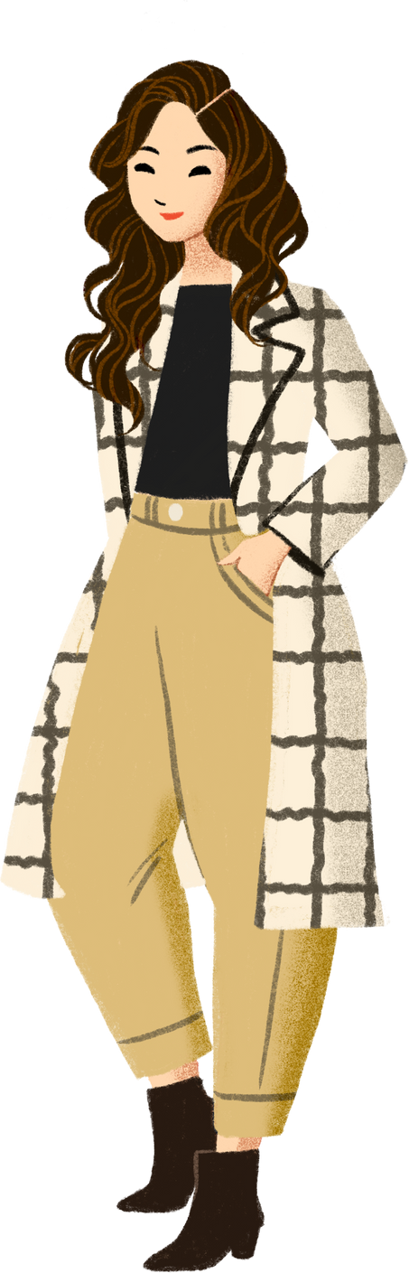




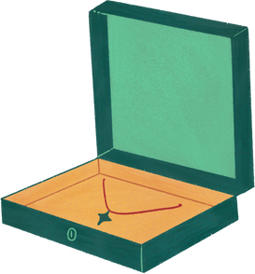








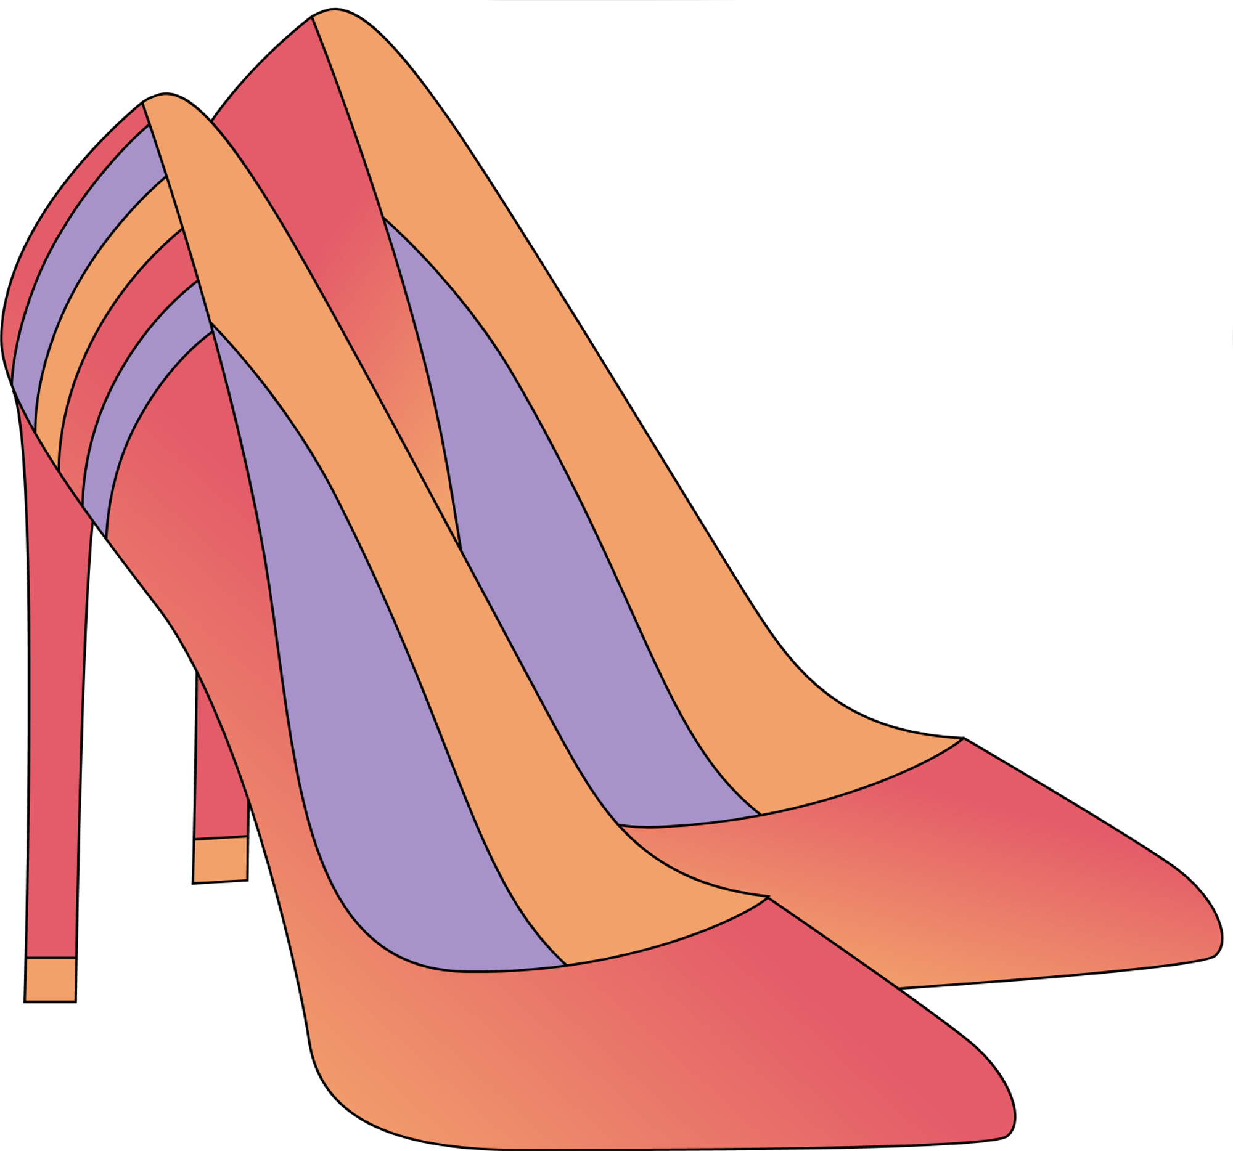

English YEAR 2
MODULE 7:
GET DRESSED

Slide 2



LESSON OBJECTIVES
By the end of the lesson, pupils will be able to:
1. Understand with support, specific information and details of simple sentences.
2. Read and enjoy simple print and digital games at sentence level.

Slide 3



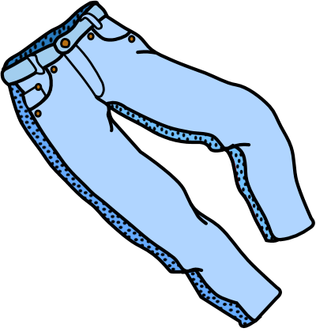
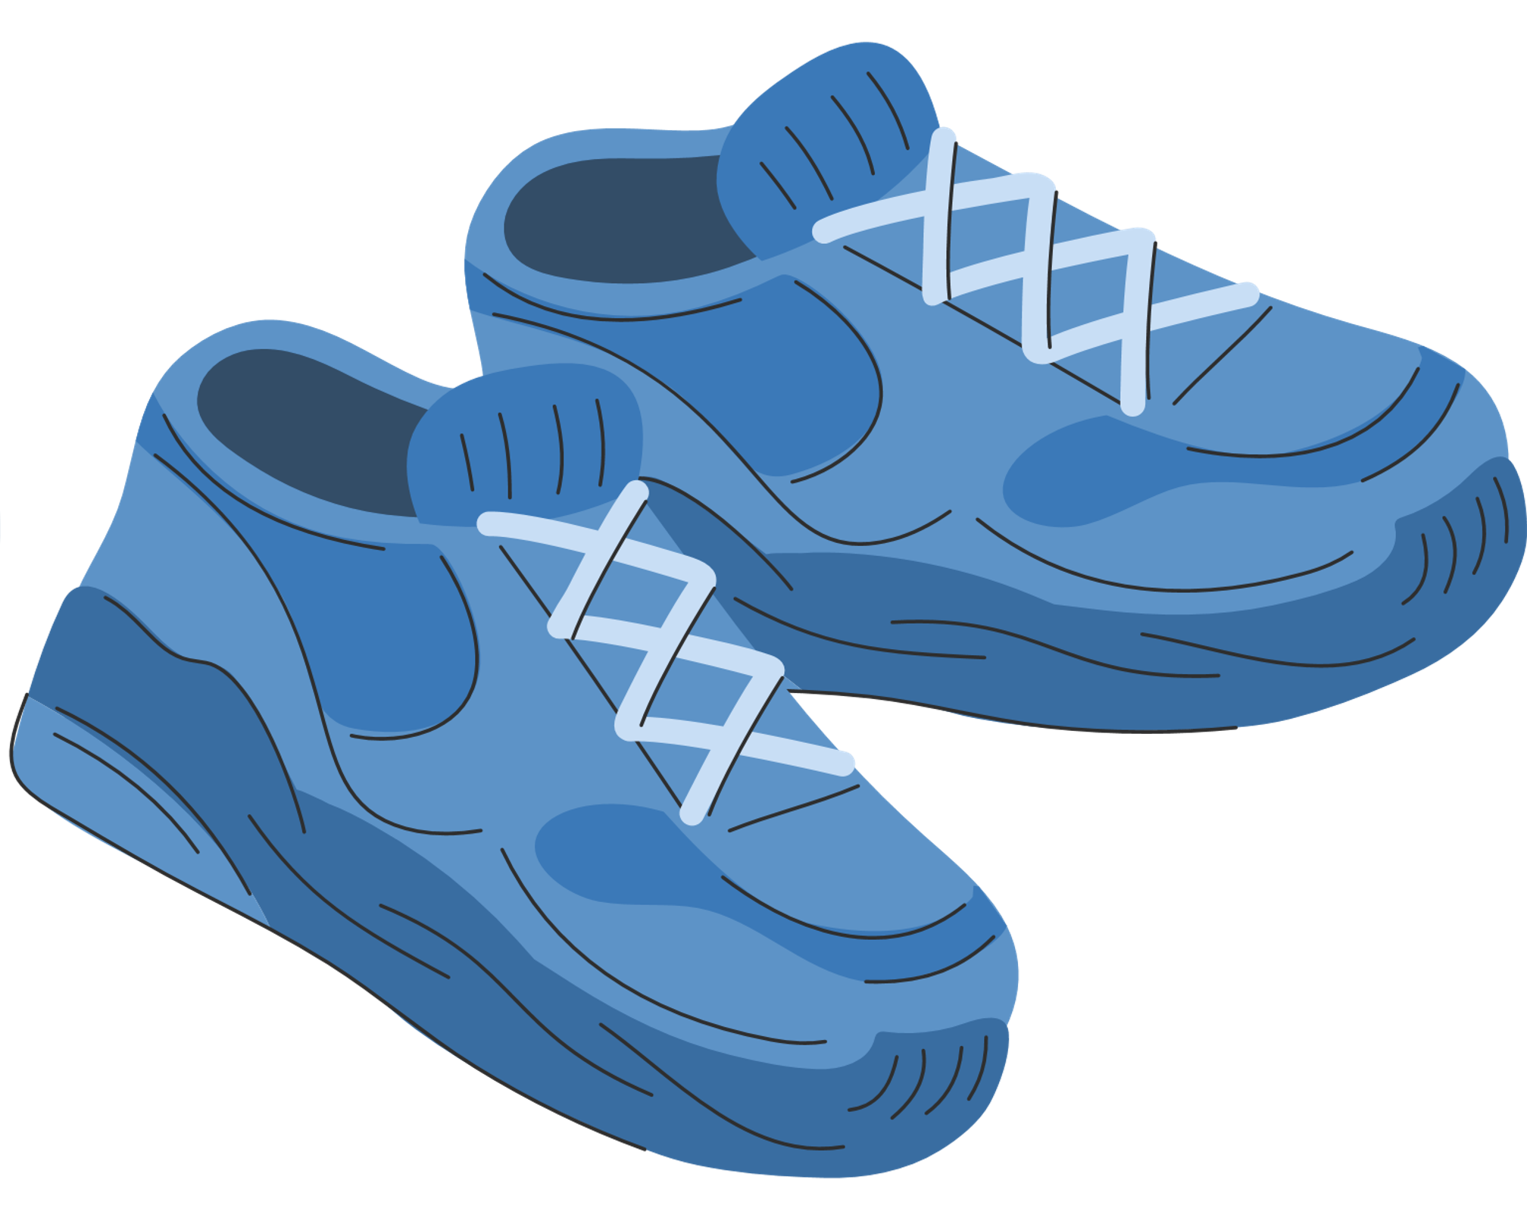

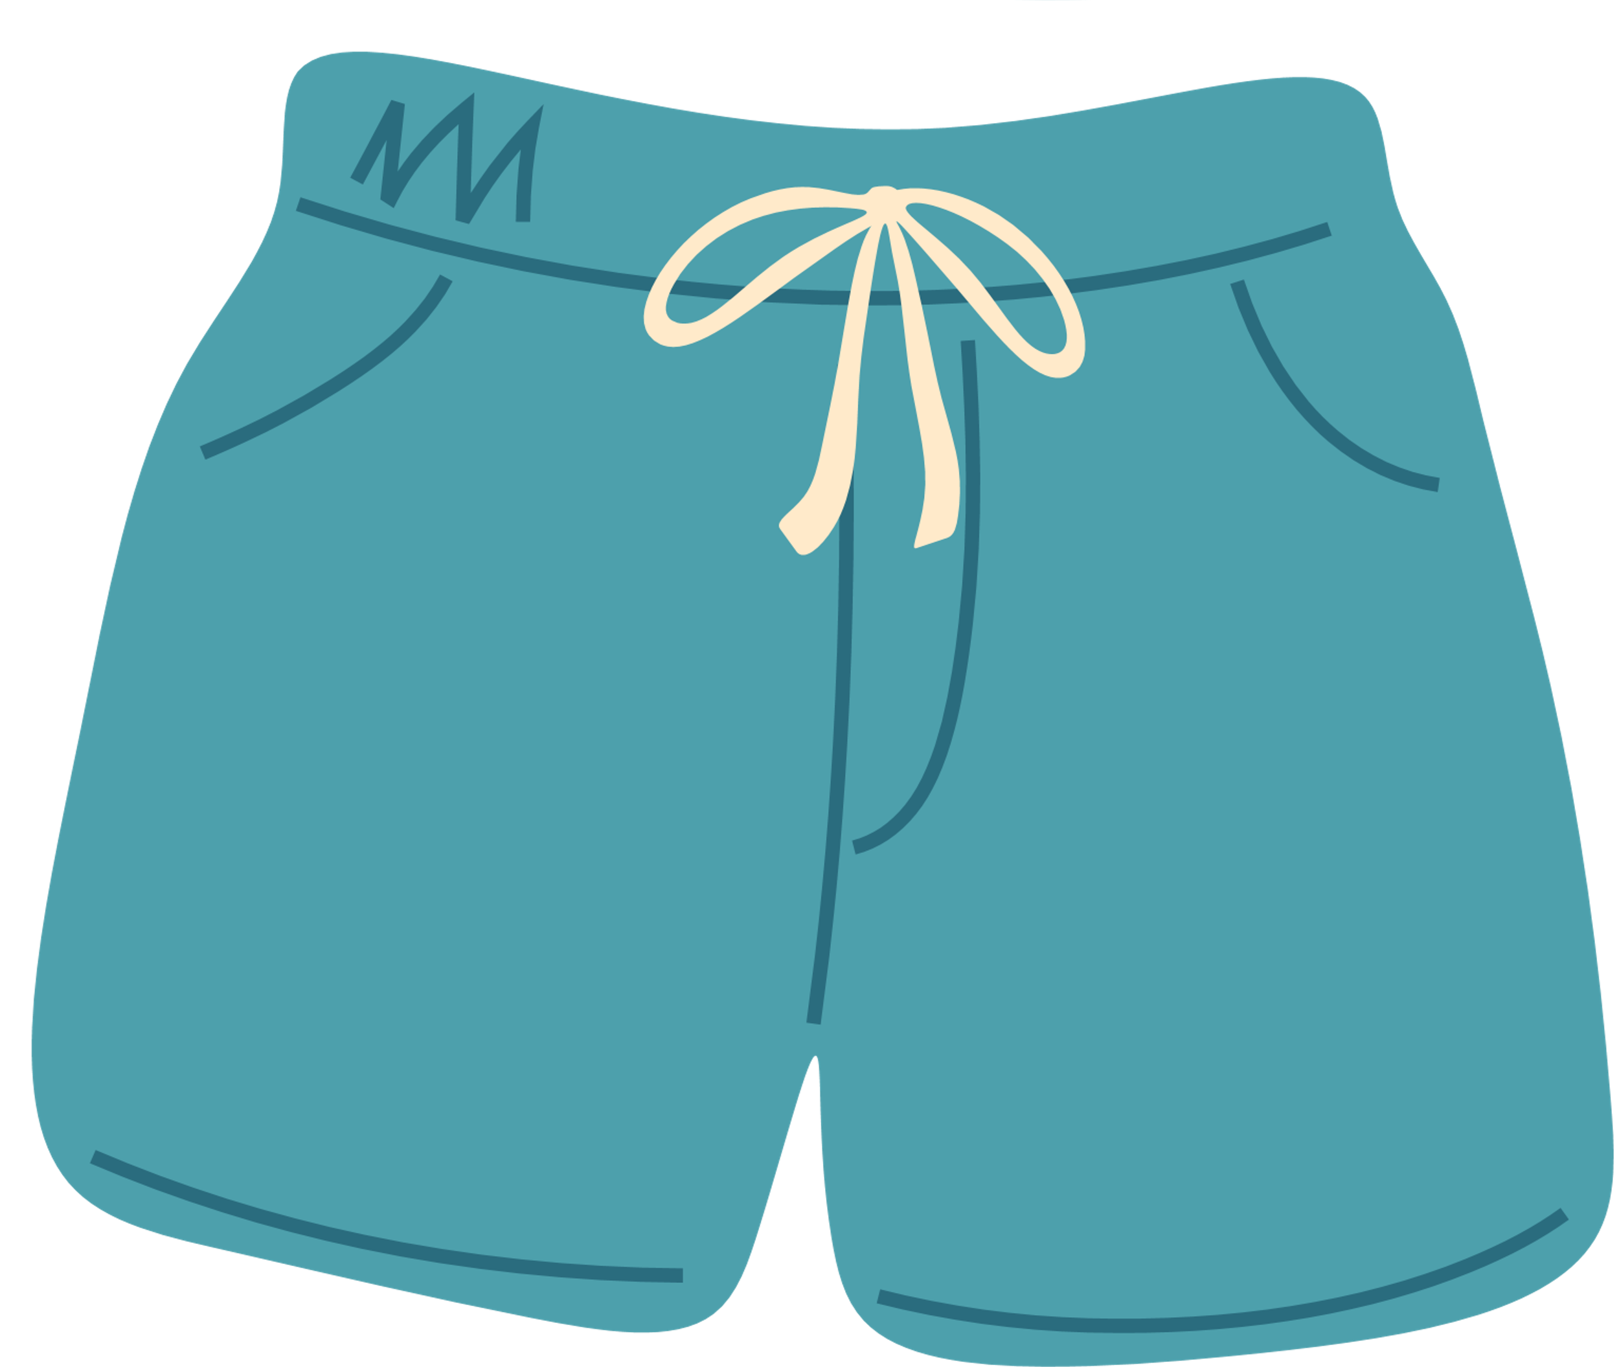

LET'S GET TO KNOW ABOUT OUR CLOTHES.
jeans
sweater
skirt
T-shirt
shoes
socks
cap
shorts

Slide 4
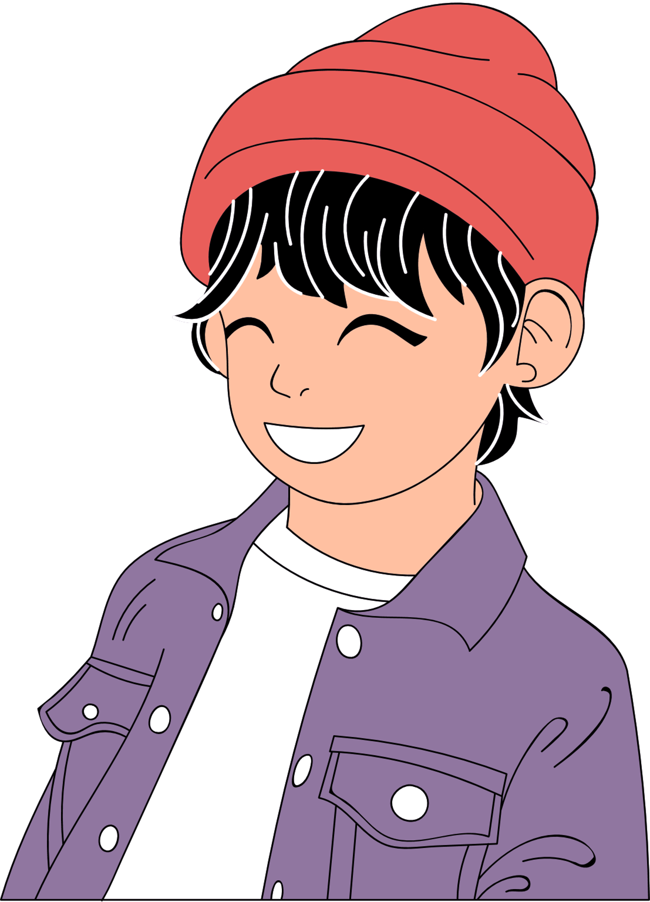

what are these people wearing?

Slide 5


What did we learn today?

Slide 6

